Slide 1
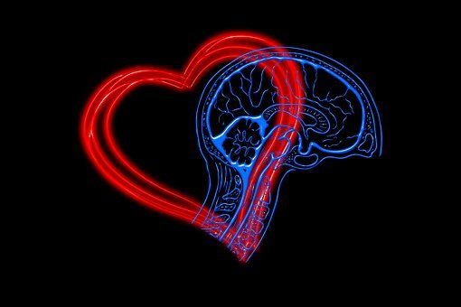
Module 1 EMOTIONAL INTELLIGENCE
1.1. What is Emotional Intelligence, Self-Awareness, Self-Management
WELCOME
Journey to lncrease your techniques of eMotional lntelligence,
digital awareNess and
entrepreneurship lifestYle
This Project (2019-1-RO01-KA204-063136) has been funded with support from the European Commission. This document reflects the views only of the author and the Commission cannot be held responsible for any use which might be made of the information contained herein.

Slide 2
Let’s Know Each Other!
Source: https://pixabay.com/illustrations/integration-welcome-shaking-hands-1777537/
Name Game - Example
Name of a friend or family member who has influenced your life
S - Serene
E - Enthusiastic
R - Resourceful
G - Grateful
I - Inspiring
U - Unhurried
Your name
A - Assertive
N - Nice
C - Cheerful
A - Appreciative
This Project (2019-1-RO01-KA204-063136) has been funded with support from the European Commission. This document reflects the views only of the author and the Commission cannot be held responsible for any use which might be made of the information contained herein.

Slide 3
Topics to be discussed
Emotional Intelligence
What is EQ and its importance
Benefits of having a high EQ
Self-Awareness
What is Self-awareness and its importance
Johari Window and how to use it
Self-Management
What is Self-management and its importance
Self-management skills and how to develop them
Components of EQ
Friedman Scale of emotional maturity
Method/ Tool for developing the EQ
Categories of Self-awareness and methods/ tools to increase it
16 personalities test for self-discovery
This Project (2019-1-RO01-KA204-063136) has been funded with support from the European Commission. This document reflects the views only of the author and the Commission cannot be held responsible for any use which might be made of the information contained herein.

Slide 4
Training Assent
Phones on silent
Ask questions
No question is silly
Be constructive
It is OK to disagree with others
Disagreement is not to be taken personally or as an attack
Have fun and enjoy yourself
.........
This Project (2019-1-RO01-KA204-063136) has been funded with support from the European Commission. This document reflects the views only of the author and the Commission cannot be held responsible for any use which might be made of the information contained herein.

Slide 5
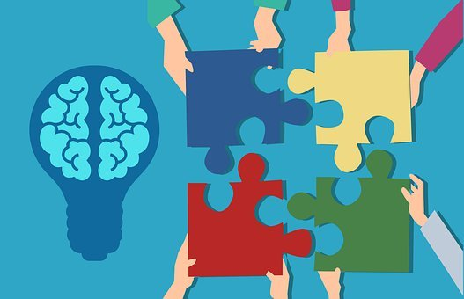
Learning objectives
Understand that emotional intelligence can be learned, educated and constantly improved
Understand what Emotional Intelligence is and identify the benefits of having higher emotional intelligence
Be able to relate more effectively to colleagues and to others
Master tools to regulate and gain control of one’s own emotions
Be aware how emotions affect our behaviour and performance
Define and practice self-awareness and self-management, in order to be able to really improve and function better in a team and to create a better work environment for oneself and co-workers
This Project (2019-1-RO01-KA204-063136) has been funded with support from the European Commission. This document reflects the views only of the author and the Commission cannot be held responsible for any use which might be made of the information contained herein.

Slide 6
Expected competencies to be attained as a result of the training
Emotional awareness
Accurate self-assessment
Self-confidence
Self-control
Trustworthiness
Conscientiousness
Adaptability
This Project (2019-1-RO01-KA204-063136) has been funded with support from the European Commission. This document reflects the views only of the author and the Commission cannot be held responsible for any use which might be made of the information contained herein.

Slide 7
Initial Assessment
This Project (2019-1-RO01-KA204-063136) has been funded with support from the European Commission. This document reflects the views only of the author and the Commission cannot be held responsible for any use which might be made of the information contained herein.

Slide 8
Emotional Intelligence
What is EQ and its importance
Components of EQ
Benefits of having a high EQ
Friedman Scale of emotional maturity
Method/ Tool for developing the EQ
This Project (2019-1-RO01-KA204-063136) has been funded with support from the European Commission. This document reflects the views only of the author and the Commission cannot be held responsible for any use which might be made of the information contained herein.

Slide 9
Types of Intelligence
Can be developed
Emotional Intelligence or Emotional Quotient (EQ)
Relational intelligence
Educational Intelligence
Financial Intelligence
Inherited
Intelligence Quotient (IQ)
This Project (2019-1-RO01-KA204-063136) has been funded with support from the European Commission. This document reflects the views only of the author and the Commission cannot be held responsible for any use which might be made of the information contained herein.

Slide 10
Emotional Intelligence
“Anybody can become angry - that is easy, but to be angry with the right person and to the right degree and at the right time and for the right purpose, and in the right way - that is not within everybody's power and is not easy.”
Aristotle
Emotional intelligence is generally defined as the ability to (a) recognize, understand, and manage our own emotions; and (b) recognize, understand, and influence the emotions of others.
This Project (2019-1-RO01-KA204-063136) has been funded with support from the European Commission. This document reflects the views only of the author and the Commission cannot be held responsible for any use which might be made of the information contained herein.

Slide 11
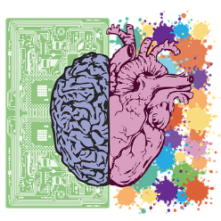
Emotional Intelligence
EQ
IQ
Ability to feel
Ability to think
Helps to take decisions
Based on logic
Helps to communicate
Helps to process information
Helps to succeed in life and workplace
Helps to succeed in school
Possible to raise EQ level
Not possible to raise IQ level
Can be learned
Cannot be learned
Source: Adapted from Dreamstime.com
“It is very important to understand that emotional intelligence is not the opposite of intelligence, it is not the triumph of heart over head – it is the unique intersection of both.” - David Caruso
This Project (2019-1-RO01-KA204-063136) has been funded with support from the European Commission. This document reflects the views only of the author and the Commission cannot be held responsible for any use which might be made of the information contained herein.

Slide 12
Emotional Intelligence
Emotional intelligence is what we use when we empathize with our co-workers, have deep conversations about our relationships with significant others, and attempt to manage an unruly or distraught child. It allows us to connect with others, understand ourselves better, and live a more authentic, healthy, and happy life.
https://positivepsychology.com/emotional-intelligence-eq/
This Project (2019-1-RO01-KA204-063136) has been funded with support from the European Commission. This document reflects the views only of the author and the Commission cannot be held responsible for any use which might be made of the information contained herein.

Slide 13
Components of EQ
SELF
How I manage myself?
SOCIAL
How I handle relationships?
Motivation
Self-awareness
Social awareness
Self-management
Social management
RECOGNITION
Who I am?
REGULATION
What I do?
Source: Adapted from pinterest.com
This Project (2019-1-RO01-KA204-063136) has been funded with support from the European Commission. This document reflects the views only of the author and the Commission cannot be held responsible for any use which might be made of the information contained herein.

Slide 14
Benefits of having a high EQ
EQ affects the quality of our lives (personal life and in the workplace) because it influences our behaviour and relationships.
It helps anyone to:
communicate better
reduce own anxiety and stress
become more resilient
defuse conflicts
improve relationships
boost performance at work
empathize with others
effectively overcome life’s challenges
This Project (2019-1-RO01-KA204-063136) has been funded with support from the European Commission. This document reflects the views only of the author and the Commission cannot be held responsible for any use which might be made of the information contained herein.

Slide 15
Benefits of having a high EQ
IQ
EQ
Success
Source: Adapted from Dreamstime.com
High IQ is only capable of predicting 20% of the factors for success
EQ is the strongest predictor of performance, explaining a full 58% of success in all types of jobs
Our emotions and beliefs can be the cause and cure of our diseases – see Dr. Ryke Hammer
This Project (2019-1-RO01-KA204-063136) has been funded with support from the European Commission. This document reflects the views only of the author and the Commission cannot be held responsible for any use which might be made of the information contained herein.

Slide 16
Friedman Scale of emotional maturity
Emotional maturity has nothing to do with age, but rather with experience, self-knowledge and personal development
Emotional maturity is a decision, not a consequence of life. Any individual can reach emotional maturity or can live his whole life as a teenager without responsibility and independence on any level
A mature person:
has a good relationship with herself/ himself
takes full control of her/ his life
This Project (2019-1-RO01-KA204-063136) has been funded with support from the European Commission. This document reflects the views only of the author and the Commission cannot be held responsible for any use which might be made of the information contained herein.

Slide 17
Friedman Scale of emotional maturity
Take the Friedman Test
This Project (2019-1-RO01-KA204-063136) has been funded with support from the European Commission. This document reflects the views only of the author and the Commission cannot be held responsible for any use which might be made of the information contained herein.

Slide 18
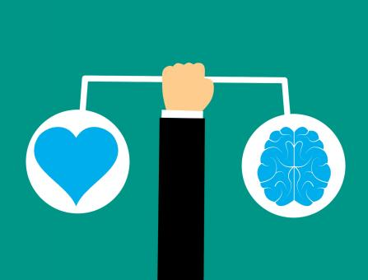
Methods/ Tools for developing EQ
Improve the way we:
Notice and understand emotions in ourselves
Notice and understand emotions in others
Mange effectively the emotion in ourselves
Use emotions to facilitate performance
Take responsibility
Show empathy
Admit own mistakes
Be unafraid of vulnerability
Recognize and accept needs
Set healthy boundaries
Source: https://www.stockvault.net/
This Project (2019-1-RO01-KA204-063136) has been funded with support from the European Commission. This document reflects the views only of the author and the Commission cannot be held responsible for any use which might be made of the information contained herein.

Slide 19
Additional Practical Exercise
Source: https://cdn.pixabay.com
Determine personal Strengths and Weaknesses
This Project (2019-1-RO01-KA204-063136) has been funded with support from the European Commission. This document reflects the views only of the author and the Commission cannot be held responsible for any use which might be made of the information contained herein.

Slide 20
Self-Awareness
What is Self-awareness and its importance
Johari Window and how to use it
Categories of Self-awareness and methods/ tools to increase it
16 personalities test for self-discovery
This Project (2019-1-RO01-KA204-063136) has been funded with support from the European Commission. This document reflects the views only of the author and the Commission cannot be held responsible for any use which might be made of the information contained herein.

Slide 21
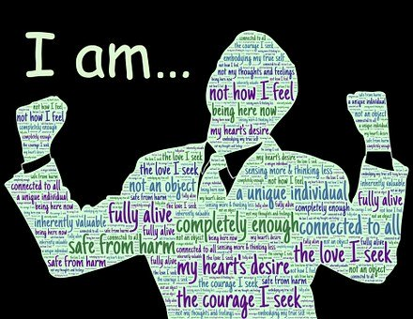
What is Self-awareness
Self-awareness is about recognizing and understanding own emotions and their effects on others, knowing own strengths and limits, being sure about self-worth and capabilities.
When we are self-aware:
we can see where our thoughts and emotions are guiding us.
we take control of our actions so we can make the necessary changes to get the outcomes we desire
Source: https://cdn.pixabay.com
This Project (2019-1-RO01-KA204-063136) has been funded with support from the European Commission. This document reflects the views only of the author and the Commission cannot be held responsible for any use which might be made of the information contained herein.

Slide 22
Johari Window
 | Things I know | Things I don’t know
Things others know | Open/ free area Information about you that both you & others know | Blind area Information about you that you don’t know, but others do know
Things others don’t know | Hidden area Information about you that you know, but others don’t know | Unknown area Information about you that neither you nor others know
This Project (2019-1-RO01-KA204-063136) has been funded with support from the European Commission. This document reflects the views only of the author and the Commission cannot be held responsible for any use which might be made of the information contained herein.

Slide 23
Methods/ Tools to increase Self-awareness
Categories of self-awareness:
Internal – we clearly see our values, passions and aspirations
External – we clearly see how other people view us
Steps for increasing Self-awareness
Ask “What?” instead of “Why?”
Create time and space for ourselves
Become better listener and ask for feedback
Source: https://images.pexels.com
This Project (2019-1-RO01-KA204-063136) has been funded with support from the European Commission. This document reflects the views only of the author and the Commission cannot be held responsible for any use which might be made of the information contained herein.

Slide 24
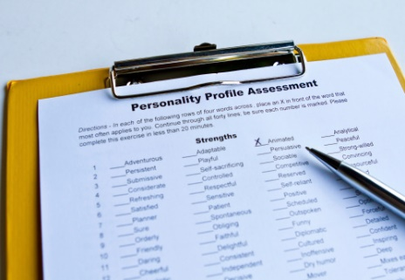
16 personalities test for self-discovering
Myers-Briggs Type Indicator™ - a well-known instrument that measures personality types and preferences
It opens the door to objective self-awareness, helping us see aspects of ourselves that could be improved and how to use our existing strengths even better
https://www.16personalities.com/ - select your language
Source: https://media.istockphoto.com
This Project (2019-1-RO01-KA204-063136) has been funded with support from the European Commission. This document reflects the views only of the author and the Commission cannot be held responsible for any use which might be made of the information contained herein.

Slide 25
Additional Practical Exercise
Things I’ve done today | Why am I doing that: for me, for someone else, what’s the purpose? | Is it in accordance with my values and deep believes? Am I doing it for wrong reasons? Is it taking up most of my time? | How do I feel at the respective moment? What is my emotion? Is it anger, sadness, fear, joy, love, surprise, disgust, shame?
……………
……………
Monitor the things you are doing in a day
This Project (2019-1-RO01-KA204-063136) has been funded with support from the European Commission. This document reflects the views only of the author and the Commission cannot be held responsible for any use which might be made of the information contained herein.

Slide 26
Self-Management
What is Self-management and its importance
Self-management skills and how to develop them
This Project (2019-1-RO01-KA204-063136) has been funded with support from the European Commission. This document reflects the views only of the author and the Commission cannot be held responsible for any use which might be made of the information contained herein.

Slide 27
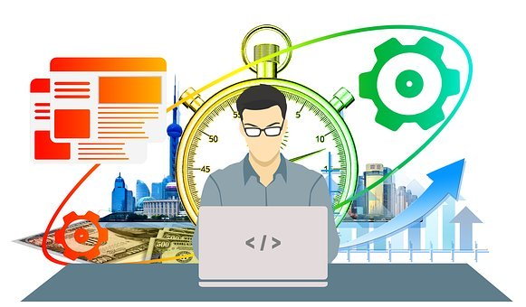
What is Self-management
Self-management is about self-control, managing own moods, adaptability and transformation.
Self-management means taking responsibility for our own actions and doing things as well as we can
Daniel Goleman – 6 traits:
Source: https://cdn.pixabay.com
self-control
transparency
adaptability
achievement
initiative
optimism
This Project (2019-1-RO01-KA204-063136) has been funded with support from the European Commission. This document reflects the views only of the author and the Commission cannot be held responsible for any use which might be made of the information contained herein.

Slide 28
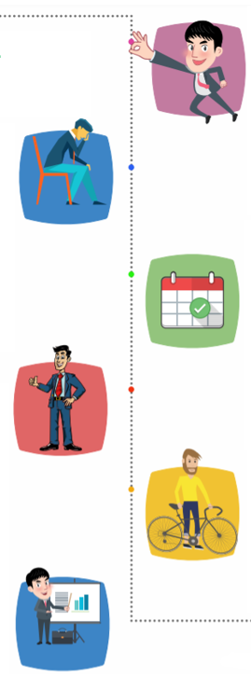
Self-management Skills and Tips
Self confidence
Stress Management
Time management and organizational skills
Self-motivation
Have a healthy lifestyle and a balance diet
This Project (2019-1-RO01-KA204-063136) has been funded with support from the European Commission. This document reflects the views only of the author and the Commission cannot be held responsible for any use which might be made of the information contained herein.

Slide 29
Additional Practical Exercise
When you feel overwhelmed with emotions, go through these steps
This Project (2019-1-RO01-KA204-063136) has been funded with support from the European Commission. This document reflects the views only of the author and the Commission cannot be held responsible for any use which might be made of the information contained herein.

Slide 30
Final Assessment
This Project (2019-1-RO01-KA204-063136) has been funded with support from the European Commission. This document reflects the views only of the author and the Commission cannot be held responsible for any use which might be made of the information contained herein.

Slide 31
Conclusions
Feedback
This Project (2019-1-RO01-KA204-063136) has been funded with support from the European Commission. This document reflects the views only of the author and the Commission cannot be held responsible for any use which might be made of the information contained herein.

Slide 32
Further reading and further development
“Emotional Intelligence”, Daniel Goleman, 1995
“A Theory of Objective Self Awareness”, Shelley Duval, Robert A. Wicklund - Academic Press, 1972
“How to Be a STAR at Work: 9 Breakthrough Strategies You Need to Succeed”, Robert E. Kelley, (New York: Times Books, 1998)
“The Emotionally Intelligent Manager: How to Develop and Use the Four Key Emotional Skills of Leadership”, Caruso D. R., & Salovey P., (2004)
https://www.talentsmart.com/ - resources available in 25 languages
https://www.emotionalintelligencecourse.com/ -
https://positivepsychology.com/emotional-intelligence-scales/
.... (see JIMINY Self-Help Handbook)
This Project (2019-1-RO01-KA204-063136) has been funded with support from the European Commission. This document reflects the views only of the author and the Commission cannot be held responsible for any use which might be made of the information contained herein.

Slide 33
Learning is a journey,
not a destination!
Thank you for taking this „journey“!
This Project (2019-1-RO01-KA204-063136) has been funded with support from the European Commission. This document reflects the views only of the author and the Commission cannot be held responsible for any use which might be made of the information contained herein.

