Slide 1
Module 3 ENTREPRENEURSHIP LIFESTYLE
3.1. What does it mean to have an entrepre-neurship lifestyle/ thinking?
How to take economi-cally safe decisions?
Journey to lncrease your techniques of eMotional lntelligence,
digital awareNess and
entrepreneurship lifestYle
This Project (2019-1-RO01-KA204-063136) has been funded with support from the European Commission. This document reflects the views only of the author and the Commission cannot be held responsible for any use which might be made of the information contained herein.

Slide 2
Training outline
Time | Activity
45 min | Welcoming & Introduction to the module
15 min | Initial test
45 min | Overview of an Entrepreneurial Lifestyle and Mindset
45 min | Entrepreneurial Decision-Making
45 min 16 min | Different Types of Entrepreneurs Video (TED Talk)
20 min | Final assessment quiz & Conclusions
TOTAL = ~4h
This Project (2019-1-RO01-KA204-063136) has been funded with support from the European Commission. This document reflects the views only of the author and the Commission cannot be held responsible for any use which might be made of the information contained herein.

Slide 3
Let’s get to know each other better!
By Wavebreakmedia, Getty Images Pro via canva.com
This Project (2019-1-RO01-KA204-063136) has been funded with support from the European Commission. This document reflects the views only of the author and the Commission cannot be held responsible for any use which might be made of the information contained herein.

Slide 4
Learning objectives
Understanding the nature and the characteristics of entrepreneurial lifestyle and mindset
Evaluating the importance of entrepreneurial attitude and thinking
Identifying the difference between “entrepreneurship” and “intrapreneurship”
Comprehending the process of entrepreneurial decision making and problem-solving procedures leading to safer economic choices
Identifying personal attributes that enable the best use of entrepreneurial opportunities
Exploring best practices in different entrepreneurship lifestyles
Finding effective ways to upgrade the existing mindset, leading to economically safe decisions
This Project (2019-1-RO01-KA204-063136) has been funded with support from the European Commission. This document reflects the views only of the author and the Commission cannot be held responsible for any use which might be made of the information contained herein.

Slide 5
Expected competencies to be attained during the training:
Self-reflection
Opportunity-seeking
Initiative
Goal setting
Persistence
Commitment
Taking calculated risks
Effective decision-making
Problem solving
Information seeking
Mindset’s upgrading
This Project (2019-1-RO01-KA204-063136) has been funded with support from the European Commission. This document reflects the views only of the author and the Commission cannot be held responsible for any use which might be made of the information contained herein.

Slide 6
Initial Test
This Project (2019-1-RO01-KA204-063136) has been funded with support from the European Commission. This document reflects the views only of the author and the Commission cannot be held responsible for any use which might be made of the information contained herein.

Slide 7
Overview of an Entrepreneurial Lifestyle and Mindset
“What is entrepreneurial thinking to you?”
By Sergey_Peterman, Getty Images via canva.com
This Project (2019-1-RO01-KA204-063136) has been funded with support from the European Commission. This document reflects the views only of the author and the Commission cannot be held responsible for any use which might be made of the information contained herein.

Slide 8
Literally, the word loan for the term “entrepreneur”….
….goes back to the old French war vocabulary of the 18th century where “entreprende” means “to undertake” – an act that combines strategy, organization and risk.
By aga7ta,
Getty Images via canva.com
This Project (2019-1-RO01-KA204-063136) has been funded with support from the European Commission. This document reflects the views only of the author and the Commission cannot be held responsible for any use which might be made of the information contained herein.

Slide 9
Nowadays, an entrepreneur is…
“a person who organizes and manages any enterprise, especially a business, usually with considerable initiative and risk”.
Entrepreneurs can sell anything: from products to services and from information to attention!
By Peshkova, Getty Images via canva.com
This Project (2019-1-RO01-KA204-063136) has been funded with support from the European Commission. This document reflects the views only of the author and the Commission cannot be held responsible for any use which might be made of the information contained herein.

Slide 10
Having an entrepreneurial thinking means so much more than starting and running a successful business!
The entrepreneurial mindset is about a certain way of thinking and living.
It is about the way we believe in ourselves, seek motivation, encourage our own creativity, improve our skills, face challenges, take risks, build relations, find solutions and accept responsibility for our actions!
This Project (2019-1-RO01-KA204-063136) has been funded with support from the European Commission. This document reflects the views only of the author and the Commission cannot be held responsible for any use which might be made of the information contained herein.

Slide 11
Why is entrepreneurial thinking Important?
A person with entrepreneurial mindset has the ability to view needs, problems and challenges as opportunities.
An employee with an entrepreneurial mindset is also known as “internal entrepreneur” or “intrapreneur” and these people are among the most valued and desired kinds of employees.
This Project (2019-1-RO01-KA204-063136) has been funded with support from the European Commission. This document reflects the views only of the author and the Commission cannot be held responsible for any use which might be made of the information contained herein.

Slide 12
“What are the main characteristics of an entrepreneurial mindset?”
This Project (2019-1-RO01-KA204-063136) has been funded with support from the European Commission. This document reflects the views only of the author and the Commission cannot be held responsible for any use which might be made of the information contained herein.

Slide 13
Practical exercise
Exercise:
“The entrepreneurial mindset in action”
This Project (2019-1-RO01-KA204-063136) has been funded with support from the European Commission. This document reflects the views only of the author and the Commission cannot be held responsible for any use which might be made of the information contained herein.

Slide 14
Entrepreneurial Decision-Making
1: Identify the decision
2: Gather relevant information
3: Identify the alternatives
4: Weigh the evidence
5: Choose among alternatives
6: Take action
7: Review decision
Seven steps to effective decision making Source: University of Massachusetts https://www.umassd.edu/fycm/decision-making/process
This Project (2019-1-RO01-KA204-063136) has been funded with support from the European Commission. This document reflects the views only of the author and the Commission cannot be held responsible for any use which might be made of the information contained herein.

Slide 15
Entrepreneurial Decision-Making
What kind of decision-maker are you?
Fast
Procrastinator
Unconve-ntional
People pleaser
Hates risks
Cautious
Regretful
Intuitive
"Passes the parcel" to others
Types of decision-makers
Based on Zamler, G. (2020), “The Ability to Take Calculated Risks”,
Entrepreneurship for Kids™, https://www.tomorrowsuccess.com/calculatedrisks.html
This Project (2019-1-RO01-KA204-063136) has been funded with support from the European Commission. This document reflects the views only of the author and the Commission cannot be held responsible for any use which might be made of the information contained herein.

Slide 16
Practical exercise
Exercise:
How do we make decisions?
This Project (2019-1-RO01-KA204-063136) has been funded with support from the European Commission. This document reflects the views only of the author and the Commission cannot be held responsible for any use which might be made of the information contained herein.

Slide 17
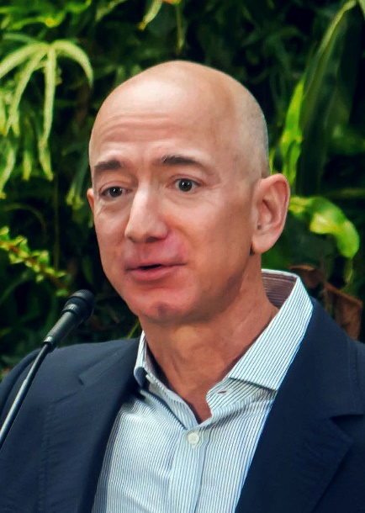
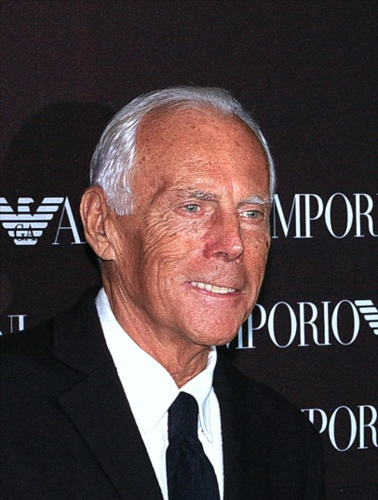
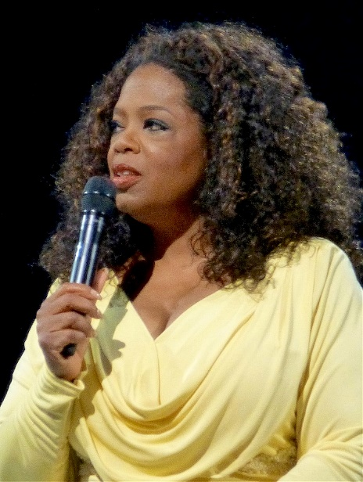
Different Types of Entrepreneurs
Innovators
Hustlers
Imitators
Researchers
Buyers
Jeff Bezos, Giorgio Armani, Oprah Winfrey Source: Wikipedia.org
This Project (2019-1-RO01-KA204-063136) has been funded with support from the European Commission. This document reflects the views only of the author and the Commission cannot be held responsible for any use which might be made of the information contained herein.
Jeff Bezos, Oprah Winfrey, Giorgio Armani Source: Wikipedia.org

Slide 18
TED Talks: How boredom can lead to your most brilliant ideas, Manoush Zomorodi
(subtitles in 23 languages, 16 min.)
This Project (2019-1-RO01-KA204-063136) has been funded with support from the European Commission. This document reflects the views only of the author and the Commission cannot be held responsible for any use which might be made of the information contained herein.

Slide 19
Practical exercise
Exercise:
“Learning from successful entrepreneurs”
This Project (2019-1-RO01-KA204-063136) has been funded with support from the European Commission. This document reflects the views only of the author and the Commission cannot be held responsible for any use which might be made of the information contained herein.

Slide 20
Final Test
This Project (2019-1-RO01-KA204-063136) has been funded with support from the European Commission. This document reflects the views only of the author and the Commission cannot be held responsible for any use which might be made of the information contained herein.

Slide 21
Discussion & Conclusions
This Project (2019-1-RO01-KA204-063136) has been funded with support from the European Commission. This document reflects the views only of the author and the Commission cannot be held responsible for any use which might be made of the information contained herein.

Slide 22
Further reading and further development
European Commission, “Erasmus for Young Entrepreneurs” (a cross-border programme facilitating the exchange of entrepreneurial and management experience), more information https://ec.europa.eu/growth/smes/supporting-entrepreneurship/erasmus-young-entrepreneurs_en
European Commission, “Supporting entrepreneurship”, more information https://ec.europa.eu/growth/smes/supporting-entrepreneurship_en
Holgate, Mandie (2020, June 4th), “How to Take Calculated Risk to Achieve Success”, Lifehack, available online https://www.lifehack.org/768345/how-to-take-calculated-risk
Nastor, Jonny (2020) “Entrepreneurial Mindset: How to Think Like an Entrepreneur”, Hack the entrepreneur, available online https://hacktheentrepreneur.com/entrepreneurial-mindset
Risk Management, Investopedia, various sources available online https://www.investopedia.com/risk-management-4689652
Robehmed, Natalie (2013), “100 best websites for entrepreneurs”, Forbes, available online https://www.forbes.com/sites/natalierobehmed/2013/11/12/100-best-websites-for-entrepreneurs/#57ce767829f6
TREND (Training Refugees in Entrepreneurial Skills using Digital Devices) - a European Union funded initiative that aims at helping refugees set up their own business, http://trend.credinfo.eu/
Sound of Business (S.O.B.), a European Union funded initiative that aims at boosting business skills through an innovative training approach based on the idea that music (in particular the history of Rock music) can be used as a cue to train adults about management, business and entrepreneurship, https://soundofbusiness.eu
Self-Regenerate, a European Project that aims at increasing the opportunities for entrepreneurial careers of young people in peripheral regions, https://www.selfregenerate.eu
This Project (2019-1-RO01-KA204-063136) has been funded with support from the European Commission. This document reflects the views only of the author and the Commission cannot be held responsible for any use which might be made of the information contained herein.

Slide 23
Thank you…
This Project (2019-1-RO01-KA204-063136) has been funded with support from the European Commission. This document reflects the views only of the author and the Commission cannot be held responsible for any use which might be made of the information contained herein.

