Slide 1
Module 2 DIGITAL AWARENESS
2.2. How to Create Digital Resources/ Content?
How to use Social Media
Journey to lncrease your techniques of eMotional lntelligence,
digital awareNess and
entrepreneurship lifestYle
This Project (2019-1-RO01-KA204-063136) has been funded with support from the European Commission. This document reflects the views only of the author and the Commission cannot be held responsible for any use which might be made of the information contained herein.

Slide 2
Training outline
Time | Activity
45 min. | Introduction to the module
15 min | Initial test
20 min | Office Suits explanation
30 min | Conference calls exercise
45 min | Multimedia edition explanation
30 min | Networking discussion
This Project (2019-1-RO01-KA204-063136) has been funded with support from the European Commission. This document reflects the views only of the author and the Commission cannot be held responsible for any use which might be made of the information contained herein.

Slide 3
Training outline
Time | Activity
45 min | Introduction to social media
1h 30 min | Social media strategy exercise
10 min | Conclusion of the submodule
45 min | Quiz
45 min | Final assessment
TOTAL = 7h
This Project (2019-1-RO01-KA204-063136) has been funded with support from the European Commission. This document reflects the views only of the author and the Commission cannot be held responsible for any use which might be made of the information contained herein.

Slide 4
Initial Test
This Project (2019-1-RO01-KA204-063136) has been funded with support from the European Commission. This document reflects the views only of the author and the Commission cannot be held responsible for any use which might be made of the information contained herein.

Slide 5
1.1. Office suites
This Project (2019-1-RO01-KA204-063136) has been funded with support from the European Commission. This document reflects the views only of the author and the Commission cannot be held responsible for any use which might be made of the information contained herein.

Slide 6
1.1. Office suites
This Project (2019-1-RO01-KA204-063136) has been funded with support from the European Commission. This document reflects the views only of the author and the Commission cannot be held responsible for any use which might be made of the information contained herein.

Slide 7
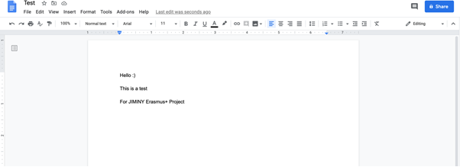
Google Docs Interface
This Project (2019-1-RO01-KA204-063136) has been funded with support from the European Commission. This document reflects the views only of the author and the Commission cannot be held responsible for any use which might be made of the information contained herein.

Slide 8
3. Practical exercises
Exercise:
Design your own CV using a template
This Project (2019-1-RO01-KA204-063136) has been funded with support from the European Commission. This document reflects the views only of the author and the Commission cannot be held responsible for any use which might be made of the information contained herein.

Slide 9
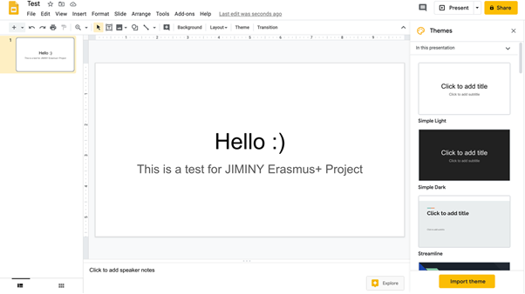
Google Slides Interface
This Project (2019-1-RO01-KA204-063136) has been funded with support from the European Commission. This document reflects the views only of the author and the Commission cannot be held responsible for any use which might be made of the information contained herein.

Slide 10
Google Sheets Interface
This Project (2019-1-RO01-KA204-063136) has been funded with support from the European Commission. This document reflects the views only of the author and the Commission cannot be held responsible for any use which might be made of the information contained herein.

Slide 11
1.2. Conference Calls Platforms
This Project (2019-1-RO01-KA204-063136) has been funded with support from the European Commission. This document reflects the views only of the author and the Commission cannot be held responsible for any use which might be made of the information contained herein.

Slide 12
1.3. Multimedia Content
GIMP
This Project (2019-1-RO01-KA204-063136) has been funded with support from the European Commission. This document reflects the views only of the author and the Commission cannot be held responsible for any use which might be made of the information contained herein.

Slide 13
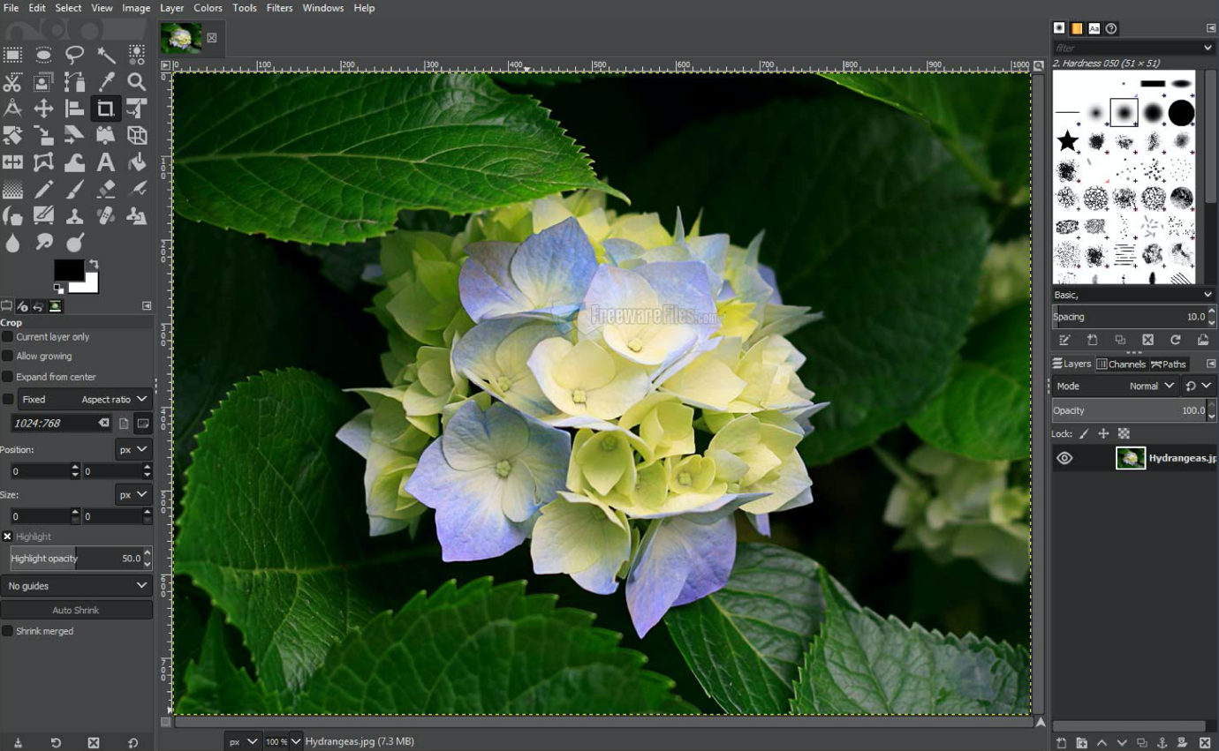
1
3
2
This Project (2019-1-RO01-KA204-063136) has been funded with support from the European Commission. This document reflects the views only of the author and the Commission cannot be held responsible for any use which might be made of the information contained herein.

Slide 14
This Project (2019-1-RO01-KA204-063136) has been funded with support from the European Commission. This document reflects the views only of the author and the Commission cannot be held responsible for any use which might be made of the information contained herein.

Slide 15
This Project (2019-1-RO01-KA204-063136) has been funded with support from the European Commission. This document reflects the views only of the author and the Commission cannot be held responsible for any use which might be made of the information contained herein.

Slide 16
This Project (2019-1-RO01-KA204-063136) has been funded with support from the European Commission. This document reflects the views only of the author and the Commission cannot be held responsible for any use which might be made of the information contained herein.

Slide 17
3. Practical exercises
Exercise:
Design your own logo
This Project (2019-1-RO01-KA204-063136) has been funded with support from the European Commission. This document reflects the views only of the author and the Commission cannot be held responsible for any use which might be made of the information contained herein.

Slide 18
1.3. Multimedia Content
DaVinci Resolve v16
This Project (2019-1-RO01-KA204-063136) has been funded with support from the European Commission. This document reflects the views only of the author and the Commission cannot be held responsible for any use which might be made of the information contained herein.

Slide 19
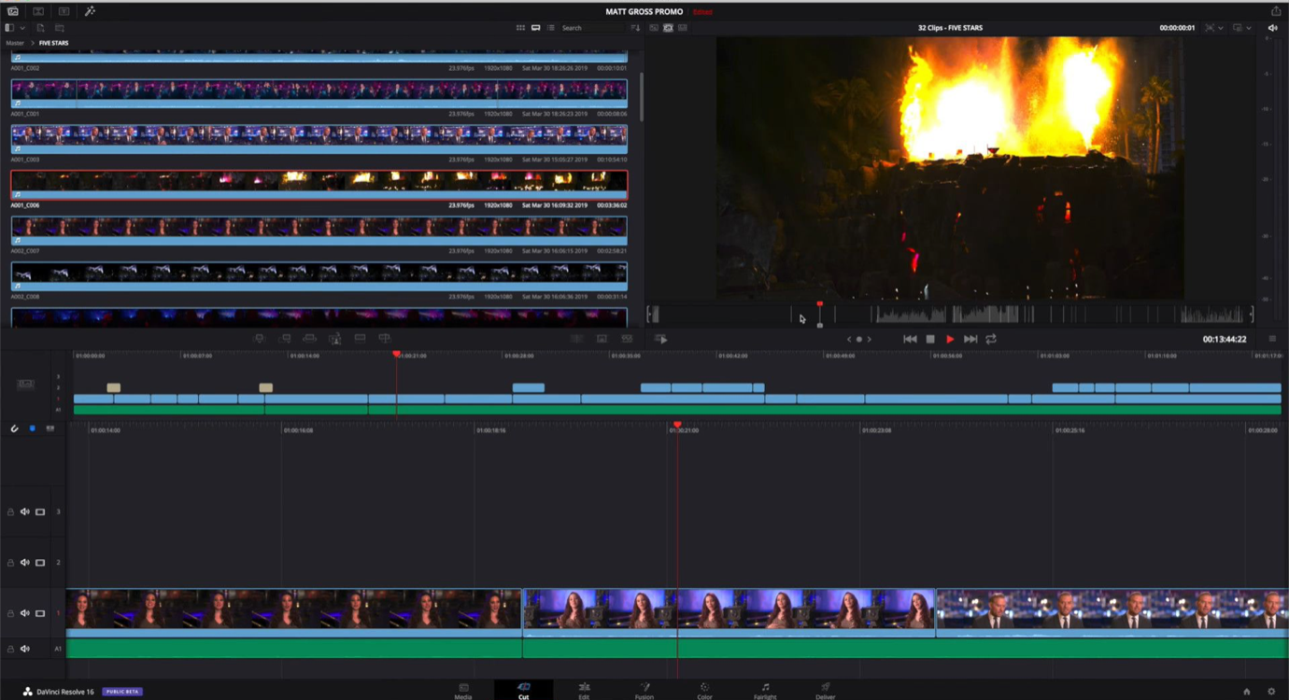
1
3
2
4
This Project (2019-1-RO01-KA204-063136) has been funded with support from the European Commission. This document reflects the views only of the author and the Commission cannot be held responsible for any use which might be made of the information contained herein.

Slide 20
This Project (2019-1-RO01-KA204-063136) has been funded with support from the European Commission. This document reflects the views only of the author and the Commission cannot be held responsible for any use which might be made of the information contained herein.

Slide 21
This Project (2019-1-RO01-KA204-063136) has been funded with support from the European Commission. This document reflects the views only of the author and the Commission cannot be held responsible for any use which might be made of the information contained herein.

Slide 22
This Project (2019-1-RO01-KA204-063136) has been funded with support from the European Commission. This document reflects the views only of the author and the Commission cannot be held responsible for any use which might be made of the information contained herein.

Slide 23
This Project (2019-1-RO01-KA204-063136) has been funded with support from the European Commission. This document reflects the views only of the author and the Commission cannot be held responsible for any use which might be made of the information contained herein.

Slide 24
2.1. Networking
Describing the importance of having a strategy and its components:
- Keywords (in CV, social media profiles…)
- Elevator pitch
- Business cards
- Adding contacts after networking
This Project (2019-1-RO01-KA204-063136) has been funded with support from the European Commission. This document reflects the views only of the author and the Commission cannot be held responsible for any use which might be made of the information contained herein.

Slide 25
2.2. “Networking 2.0”
Highlighting the importance of getting it updated, having recommendations, and joining interesting groups
This Project (2019-1-RO01-KA204-063136) has been funded with support from the European Commission. This document reflects the views only of the author and the Commission cannot be held responsible for any use which might be made of the information contained herein.

Slide 26
2.3. Use of social media as an entrepreneur
The importance of being present in different social media
This Project (2019-1-RO01-KA204-063136) has been funded with support from the European Commission. This document reflects the views only of the author and the Commission cannot be held responsible for any use which might be made of the information contained herein.

Slide 27
2.3. Use of social media as an entrepreneur
Pro-tips:
Know your audience
This Project (2019-1-RO01-KA204-063136) has been funded with support from the European Commission. This document reflects the views only of the author and the Commission cannot be held responsible for any use which might be made of the information contained herein.

Slide 28
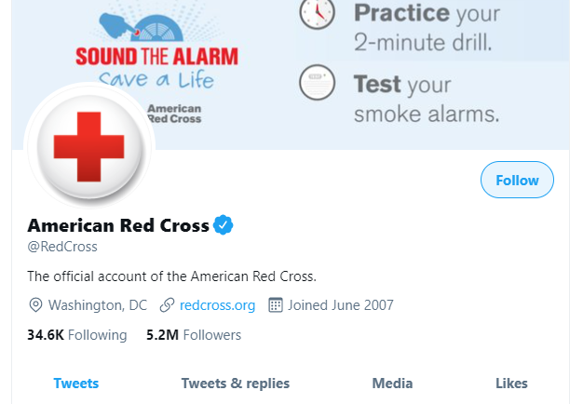
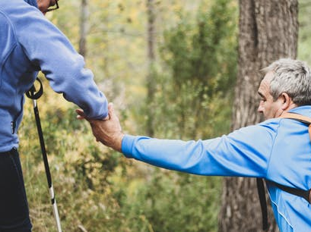
2.3. Use of social media as an entrepreneur
Pro-tips:
Show a consistent image
This Project (2019-1-RO01-KA204-063136) has been funded with support from the European Commission. This document reflects the views only of the author and the Commission cannot be held responsible for any use which might be made of the information contained herein.

Slide 29
2.3. Use of social media as an entrepreneur
Pro-tips:
Use every social network
This Project (2019-1-RO01-KA204-063136) has been funded with support from the European Commission. This document reflects the views only of the author and the Commission cannot be held responsible for any use which might be made of the information contained herein.

Slide 30
2.3. Use of social media as an entrepreneur
Pro-tips:
Have a diverse storytelling perspective
This Project (2019-1-RO01-KA204-063136) has been funded with support from the European Commission. This document reflects the views only of the author and the Commission cannot be held responsible for any use which might be made of the information contained herein.

Slide 31
2.3. Use of social media as an entrepreneur
Pro-tips:
Care about the content quality
This Project (2019-1-RO01-KA204-063136) has been funded with support from the European Commission. This document reflects the views only of the author and the Commission cannot be held responsible for any use which might be made of the information contained herein.

Slide 32
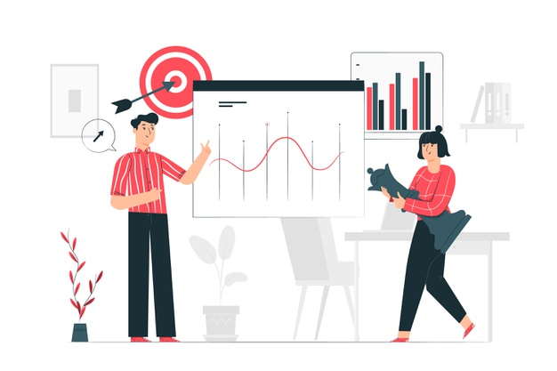
2.3. Use of social media as an entrepreneur
Pro-tips:
Plan the strategy
This Project (2019-1-RO01-KA204-063136) has been funded with support from the European Commission. This document reflects the views only of the author and the Commission cannot be held responsible for any use which might be made of the information contained herein.

Slide 33
2.3. Use of social media as an entrepreneur
Pro-tips:
Learn from successful companies
This Project (2019-1-RO01-KA204-063136) has been funded with support from the European Commission. This document reflects the views only of the author and the Commission cannot be held responsible for any use which might be made of the information contained herein.

Slide 34
3. Practical exercises
Exercise:
Develop your own social media strategy
This Project (2019-1-RO01-KA204-063136) has been funded with support from the European Commission. This document reflects the views only of the author and the Commission cannot be held responsible for any use which might be made of the information contained herein.

Slide 35
Final Test
This Project (2019-1-RO01-KA204-063136) has been funded with support from the European Commission. This document reflects the views only of the author and the Commission cannot be held responsible for any use which might be made of the information contained herein.

Slide 36
Feedback Collection
This Project (2019-1-RO01-KA204-063136) has been funded with support from the European Commission. This document reflects the views only of the author and the Commission cannot be held responsible for any use which might be made of the information contained herein.

Slide 37
Further readings
Google Suite learning Center
The ultimate guide to Google Docs
How to Use Google Slides in 2020 (Quick Start Guide).
How to use Google Sheets to Make Your First Spreadsheet.
The complete Zoom guide: From basic help to advanced tricks
Official tutorials of GIMP
DaVinci Resolve official training resources
This Project (2019-1-RO01-KA204-063136) has been funded with support from the European Commission. This document reflects the views only of the author and the Commission cannot be held responsible for any use which might be made of the information contained herein.

Slide 38
Thank you…
This Project (2019-1-RO01-KA204-063136) has been funded with support from the European Commission. This document reflects the views only of the author and the Commission cannot be held responsible for any use which might be made of the information contained herein.

